Slide 1
Progress Report 7-8-2024

Slide 2
e.g.
Explanation of parameters
target_type:
‘sigmoid’: -sigmoid((K-x)/delta)
‘indicator’: -indicator{(K-x)>0}
‘original’: (K-x) (learnt by Yx_tilde, not Yx)
trick:
‘clamp’: clamp with dYx=Yx*(1+Yx)*Zx*dB (without using Yx_tilde)
‘logit’: use Yx_tilde=logit(-Yx) --> dYx_tilde=
‘no’: learn dirctly
Progress Report:
Wraped the codes (see sample codes attached)
Add histogram plots (to show yx’s convergency to -1/0, and yc’s to 0)
Tried more sets of parameters, and find:
‘Clamp’ works best among all tricks (especially “indicator” + “clamp”)
‘Maxbacth’ = 600 is optimal (better than 1000 and 300)
‘delta’:
For “clamp” +”sigmoid”: optimal = 0.005
For ‘logit’: optimal = 0.03 (hard to say) When delta↓, yx and yc indicate conflicting effects
more yx→-1/0
less yc→0 (shifted to a positive value ≈ 0.3)
For plain ‘sigmoid”: optimal=0.01
Saved the models with best performances (no need to run again)
See relatively better results on next pages...

Slide 3
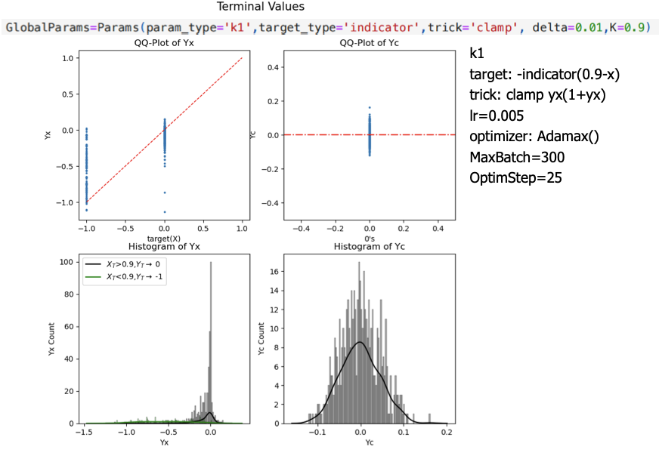
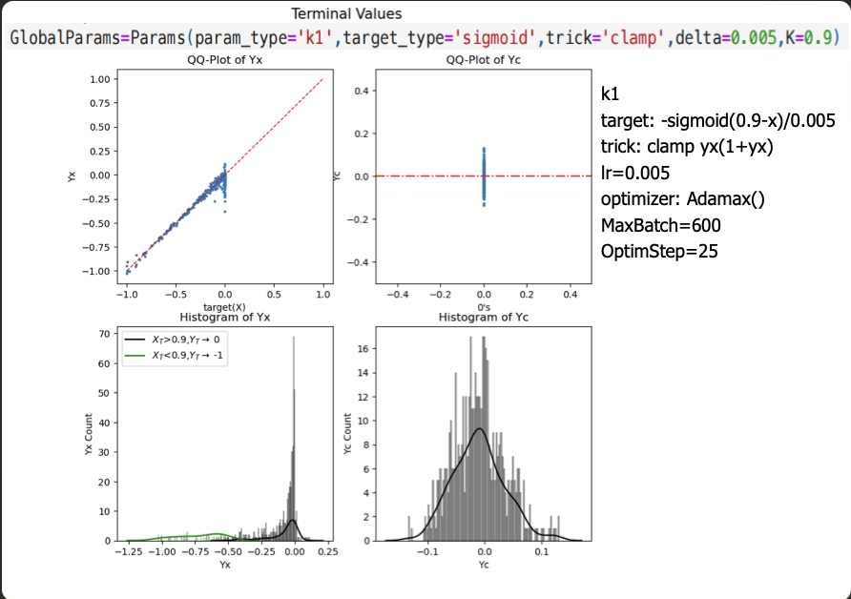
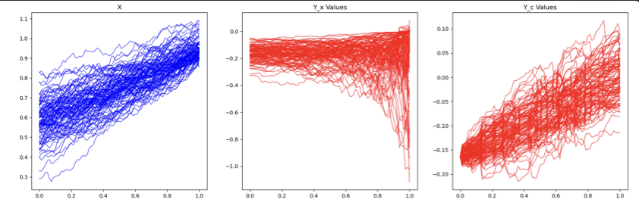
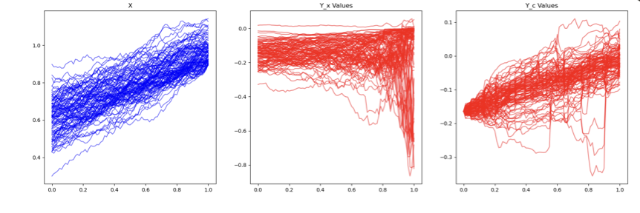
Good Results -- Top 1 and 2: Clamp

Slide 4
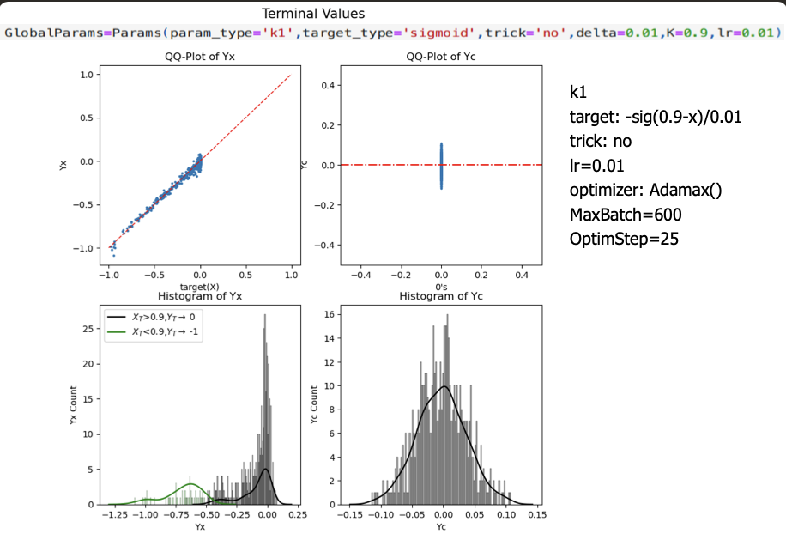
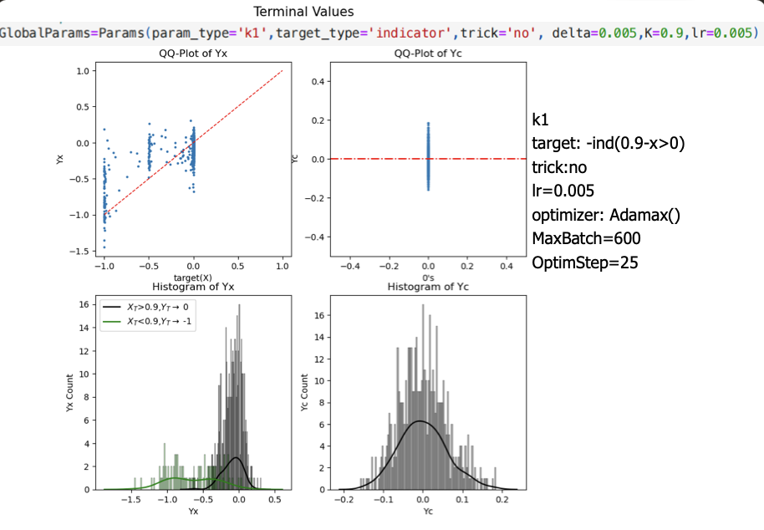
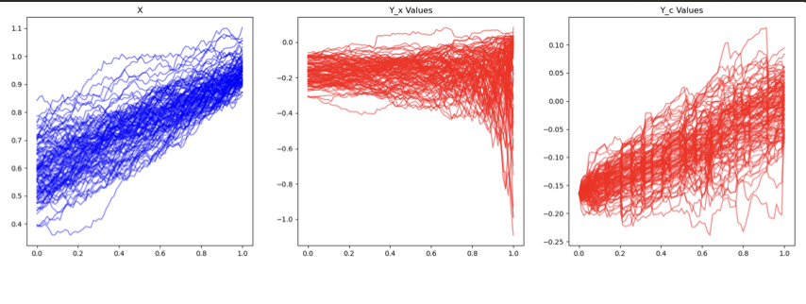
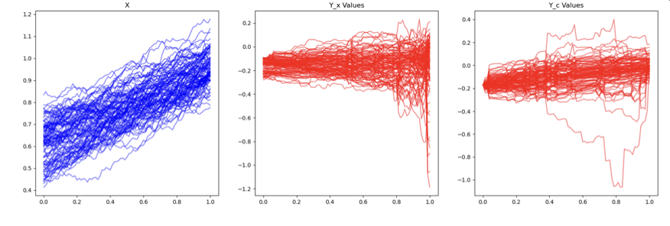
Good Results -- Top 3 and 4: no trick

Slide 5
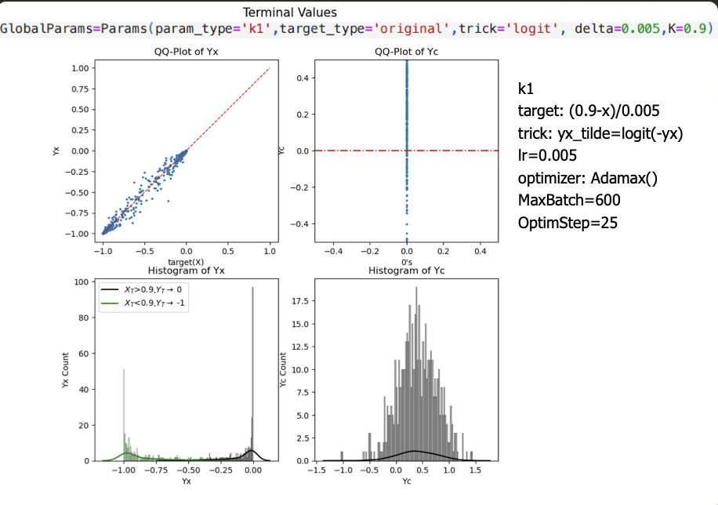
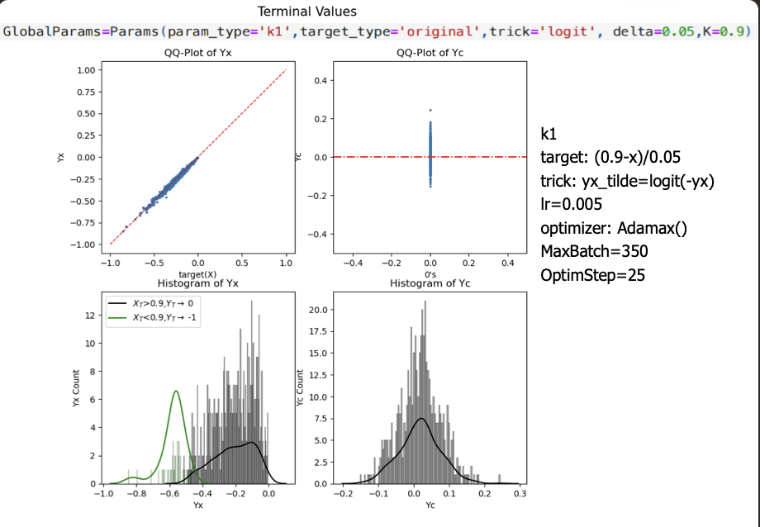
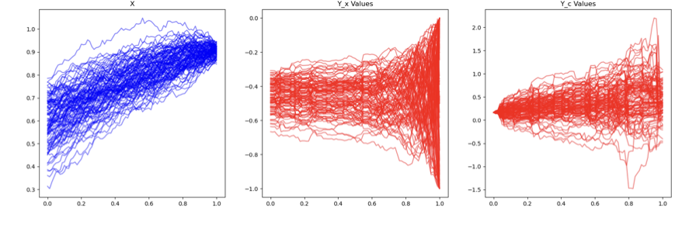
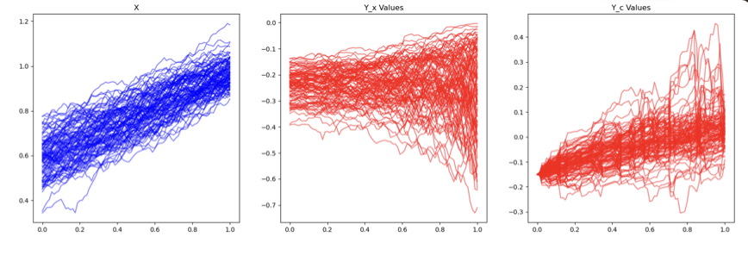
Good Results -- delta’s Conflicting Effects on Yx and Yc

Slide 6
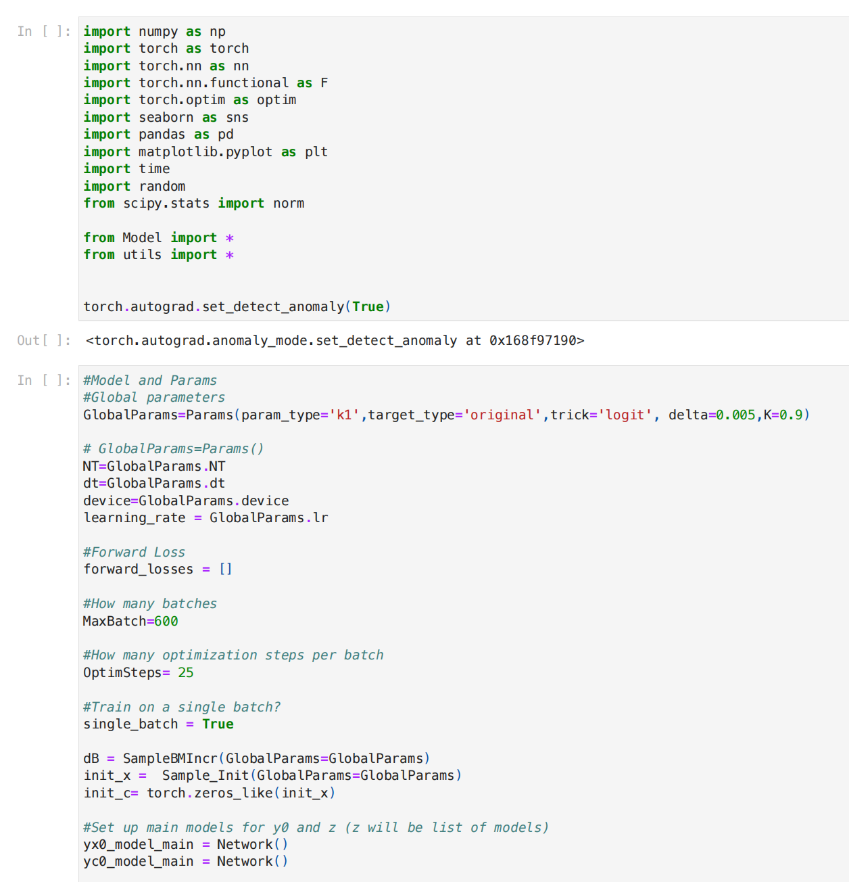
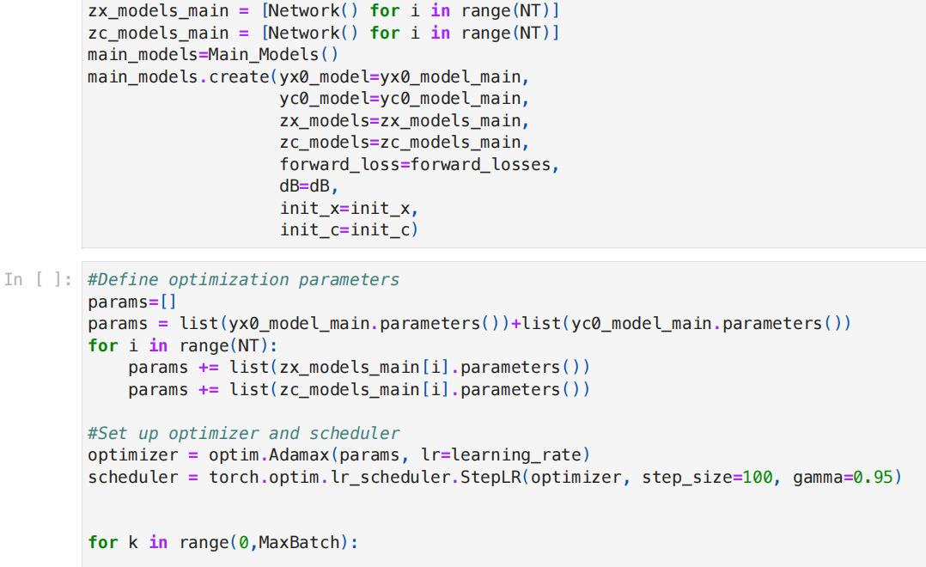
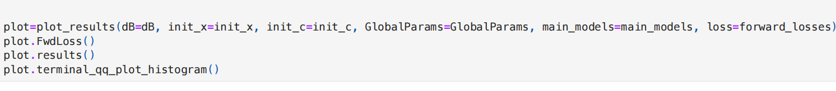
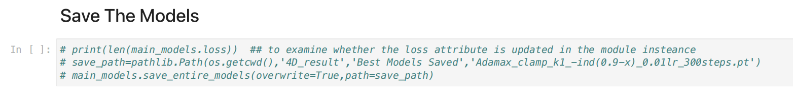




Wrapped Codes -- Model & utils
training......

Slide 7
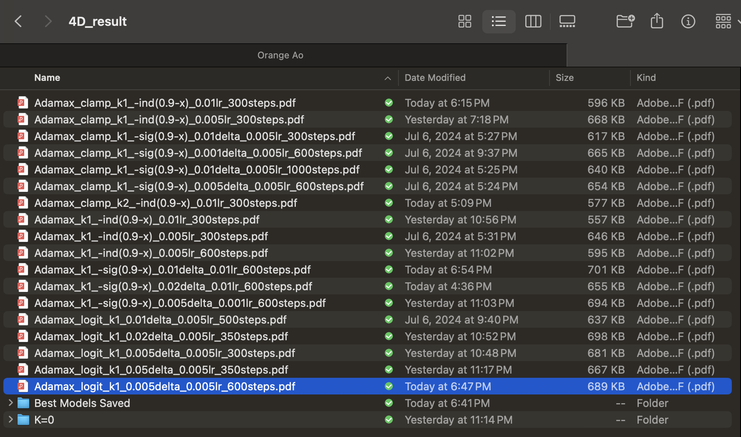
Appendix -- other attempts of paramter sets

